Slide 1



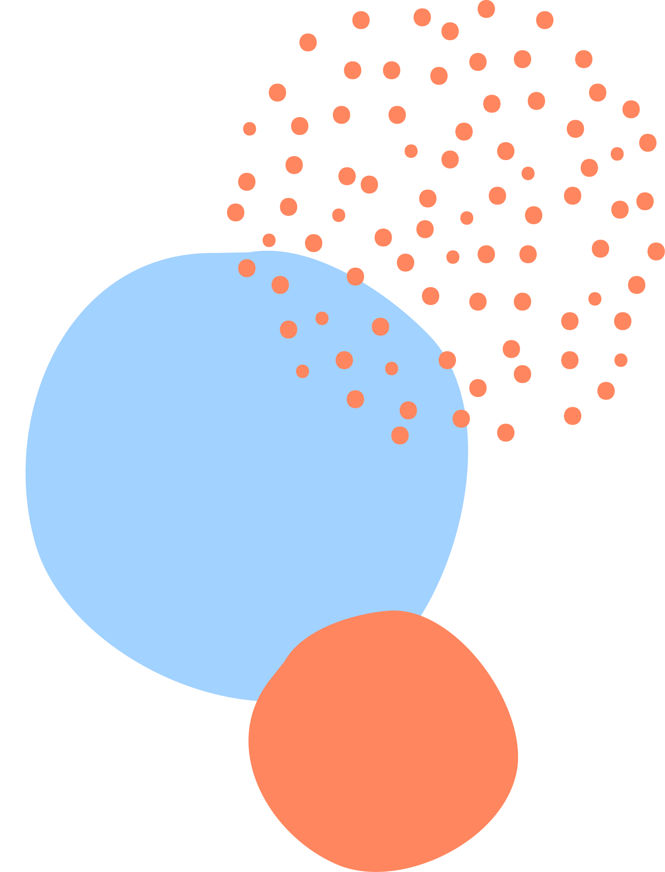
Prosci’s Change Management Process
PREPARE, MANAGE, AND SUSTAIN

Slide 2





Team Members
Anshul Singh
Meghna Allam
Mihir Sheth
Sruthi Bhaskar

Slide 3



Background

Slide 4

Background and Origin
Prosci was founded on the principle of applying research-based methods to change management, starting in the late 1990s.
The model's origins trace back to analyzing successful and unsuccessful change efforts across various organizations.
Its development was driven by the goal to create a structured, easy-to-use framework for managing the people aspect of change

Slide 5

Introduction
Prosci is the global leader in change management research and products over the last decade.
Its methodology, informed by research across 3,400+ organizations, is employed by 80% of Fortune 100 firms.
Widely adopted in business, government, and community sectors, Prosci's approach effectively manages change's people aspect.

Slide 6
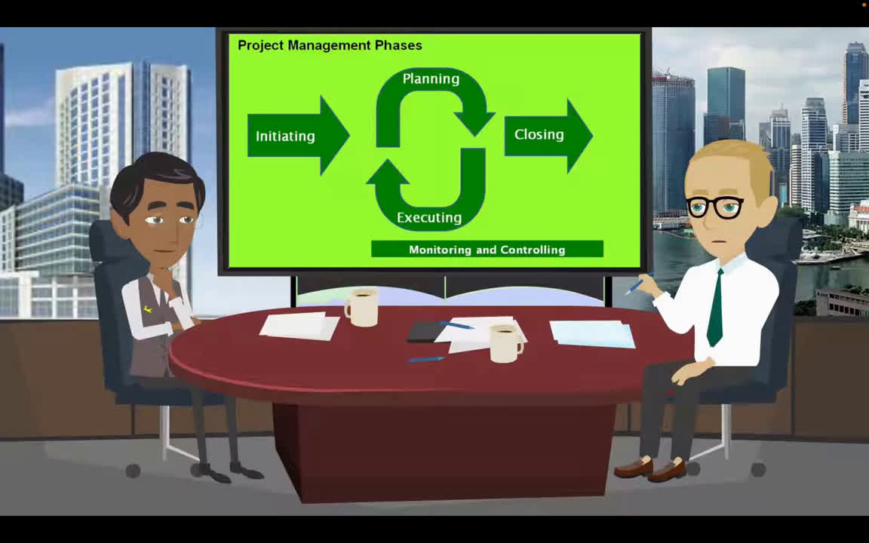

Slide 7

Three Phases of Prosci’s Model
Phase 1
Phase 3
Prepare for Change
Sustain Outcomes
Phase 2
Manage Change

Slide 8
Phase 1 - Prepare for Change
Evaluate the size, scope, and impact of the impending change to tailor the change management strategy.
Define the change management strategy, prepare the team, and develop sponsorship to support the change.
Three
Phases
Phase 2 - Manage Change
Plan and implement detailed change management strategies, communication and sponsor roadmaps.
Focus on training and resistance management to ensure smooth adoption of the change across the organization.
Phase 3 - Sustain Outcomes
Ensure changes are fully adopted and integrated into the organization's culture by collecting and analyzing feedback.
Identify gaps and manage resistance, implementing reinforcements to maintain the effectiveness.

Slide 9
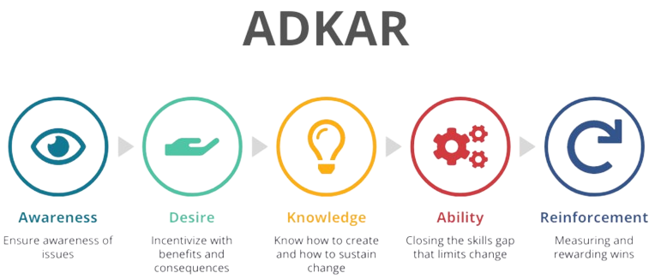
Prosci and ADKAR: A Unified Approach
Prosci's methodology incorporates the ADKAR model, using it as a foundational tool to guide individual transitions within the broader organizational change framework
Prosci outlines the overall change framework; ADKAR focuses on individual change steps.
Together, they form a complete change management approach, each serving a unique role.

Slide 10


Target Audience

Slide 11


Target Audience
Project Manager
Executive Director
Customer Success Manager
Human resources manager
External Consultant

Slide 12
Project Manager
Executive Director
Apply Prosci’s model for strategic changes in company workflows and processes.
Establish clear, targeted goals to effectively navigate and implement these changes.
Executives to involve employees in key decisions.
Use stakeholder feedback for financial choices.
Human Rescource Manager
HR to implement new workplace rules for a healthier environment.
Offer training to enhance employee skills and awareness.
External Consultant
Customer Success Manager
Experts, including those from the Big 4, lead change in major firms.
Texas A&M improved payroll with Prosci and Workday, earning a 3.84 rating.
Onboarding customers boosts product/service adoption and usage.
Customer success managers can further enhance adoption rates.

Slide 13


Structured Approach
Customizable Approach
It divides the process of change into three separate phases, each with a unique set of stages and areas of focus.
This structured approach helps organizations handle the complexity of change deliberately.
By defining success, impact, and approach in the “Prepare Approach” phase, organizations can adjust their change management strategies to fit the specific requirements of the project.
STRENGTHS
ADKAR Model Integration
The ADKAR model is known to support change at the individual level, while the Prosci’s model brings about change at the organizational level.
This integration ensures a focus on the people side of change and helps organizations address individual concerns.

Slide 14
Tracking Performance
In the “Manage Change” phase, there is a step to monitor the progress of the change, involving the creation of a tracking calendar.
By incorporating metrics into the model, organizations can evaluate and assess the success of their change initiatives.
Continuous Improvement
The model recognizes the need for continuous improvement by including a stage dedicated to “Adapting Actions” based on the insights gained throughout the process.
This is essential in situations where organizational priorities, market conditions, and external factors may change over time.
STRENGTHS
Sustaining Change Outcomes
Knowledge Transfer
It acknowledges that change management should not end with the project going live but should also extend into the post-implementation phase.
This involves developing strategies and initiatives that extend beyond the initial implementation, ensuring that the changes incorporated into the organization have a long term impact.
The final stage involves transferring ownership of the sustainment efforts.
This includes the transfer of knowledge and assets related to the change.
Effective knowledge transfer ensures that the organization retains the best practices and lessons learned from the change project.

Slide 15


Inflexibility and Rigidity
Underestimation of Resistance
May be too rigid for dynamic, fast-changing environments.
Can limit swift response to unexpected changes.
Risk of early resistance if awareness and desire are not fostered.
Case study shows resistance when change is perceived negatively.
Weakness
Overemphasis on Linear Processes
Complexity in Application
Change is complex and often non-linear.
Model may oversimplify the change process, missing underlying dynamics.
Demands significant resource investment.
Challenging for small or resource-constrained organizations.

Slide 16

Famous Use Case
One of the most cited use cases of the Prosci Model involves its application by Texas Instruments, a leading technology company. Texas Instruments used the ADKAR Model to manage change during significant organizational transformations, including technological upgrades and process improvements across various departments.
The company faced challenges in implementing new software systems and processes, which required a shift in how employees performed their tasks. To address these challenges, Texas Instruments leveraged the Model to guide the change management process. They focused on building awareness about the need for change, creating a desire among employees to support and participate in the change, providing the necessary knowledge and training for employees to adopt new systems, enhancing the ability of teams to implement the changes, and reinforcing the changes to ensure they were sustained over time.
This approach allowed Texas Instruments to achieve successful adoption of new technologies and processes, minimizing resistance and enhancing overall organizational performance. The use case of Texas Instruments is often highlighted in discussions about effective change management practices, demonstrating the practical application and benefits of the Prosci Model in a real-world corporate setting.

Slide 17
Conclusion
In simple terms, Prosci's Change Management Process is like a roadmap for organizations to navigate through changes smoothly.
It helps everyone involved understand why the change is happening, how it affects them, and what they need to do to make it work.
By focusing on things like clear communication, understanding how the change impacts individuals, and providing support and training, organizations can increase the chances of their changes being successful.
Prosci's model also emphasizes the importance of learning from the process. By regularly checking in on how things are going, making adjustments as needed, and celebrating successes along the way, organizations can build a culture that's more adaptable and resilient to change in the long run.
Prosci's Change Management Process is about empowering people to embrace and thrive in times of change, making the journey as smooth and successful as possible for everyone involved.

Slide 18
References
https://www.prosci.com/methodology/3-phase-process
https://www.youtube.com/watch?v=6hHmILGHDCA
https://change.walkme.com/prosci-change-management/
https://www.prosci.com/hubfs/Website_English/2.downloads/success-stories/Texas-AM-success-story.pdf
https://www.prosci.com/blog/how-to-introduce-change-management-by-audience-

Slide 19
Thank You

